Slide 1
Exploratory Data Analysis (EDA) for Real Estate Pricing: Unveiling the Dynamics of House Valuation in a Dynamic Market
Presented By:-Tanuja Sharma
Affiliated BY: -DIGICROME ACADEMY(Nexthikes)
Github Repository:-https://github.com/Tanuja13894

Slide 2
INTRODUCTION
The Housing Data Project is designed to analyze and interpret various aspects of housing markets. By leveraging a dataset containing comprehensive information about properties, this project aims to provide insights that can inform stakeholders such as homebuyers, real estate investors, policymakers, and urban planners. The analysis will cover trends, price predictions, demographic impacts, and more.

Slide 3
ABOUT THE PROJECT
Creating a project on housing data can be an enriching experience that combines data science, statistical analysis, and insights into real estate trends. Here’s a step-by-step guide to help you structure your project:
Define the Objective
Collect Data
Data Preparation
Exploratory Data Analysis (EDA)
Feature Engineering

Slide 4
Problem statement:-
In the dynamic landscape of the residential real estate market, Determining an optimal and competitive price for a house is a multifaceted challenge. As a key member of the analytics team in a leading real estate company, your task is to conduct a comprehensive analysis to identify and understand the myriad variables that significantly influence house prices.
By leveraging advanced data analytics techniques and visualization tools,
your goal is to uncover patterns, correlations, and trends within the dataset ,enabling the company to make informed decisions and strategically position properties for better business opportunities.

Slide 5
Problem statement:-
Price Distribuion::-
The distribution of property prices varied, showcasing a diverse range of values, potentially indicating a varied market with properties at different price points.
Bedrooms and Bathrooms:
Properties with varying numbers of bedrooms and bathrooms were available, with certain counts being more prevalent, suggesting market demand or common property configurations.
Acreage and House Sizes:
The acreage of properties and house sizes spanned a wide range, catering to different preferences and needs of potential buyers.
Sales Trends Over Time:
The analysis of previous sales dates hinted at fluctuating sales trends over the years, which could imply varying market demand or economic conditions affecting sales volumes
Factors Influencing Price:
Relationship between price and variables like the number of rooms, acreage, house size, and even zip codes indicated potential factors influencing property prices. For instance, certain attributes might contribute more to a property’s value than others.
Market Trends:
Uncovered insights into market trends, highlighted by the distribution of property prices, bedroom and bathroom counts, acreage sizes, and house sizes.
Geographic Analysis:
Identified top cities and states with the highest real estate listings, offering a geographical perspective on market prominence.
Temporal Analysis:
Observed trends in sales over time to understand market fluctuations.
Price Dynamics:
Explored relationships between price and various property attributes, discerning how they influence property values.

Slide 6
DATA EXPLORATION
1391, 81)
Understand the Dataset:-Data Sources, Data Schema
Data Inspection:-Initial Inspection, Variable Types
Data Cleaning:-Missing Values, Outliers, Duplicates
Descriptive Statistics:-Summary Statistics, Frequency Counts
Data Visualization:-Histograms, Bar Charts, Box Plots, Scatter Plots, Heatmaps.
Correlation Analysis:-Correlation Matrix, Feature Relationships
Geospatial Analysis:-Mapping, Regional Analysis
Temporal Analysis:-Time Series Analysis, Seasonal Patterns
Feature Engineering:-New Features, Feature Transformation.

Slide 7
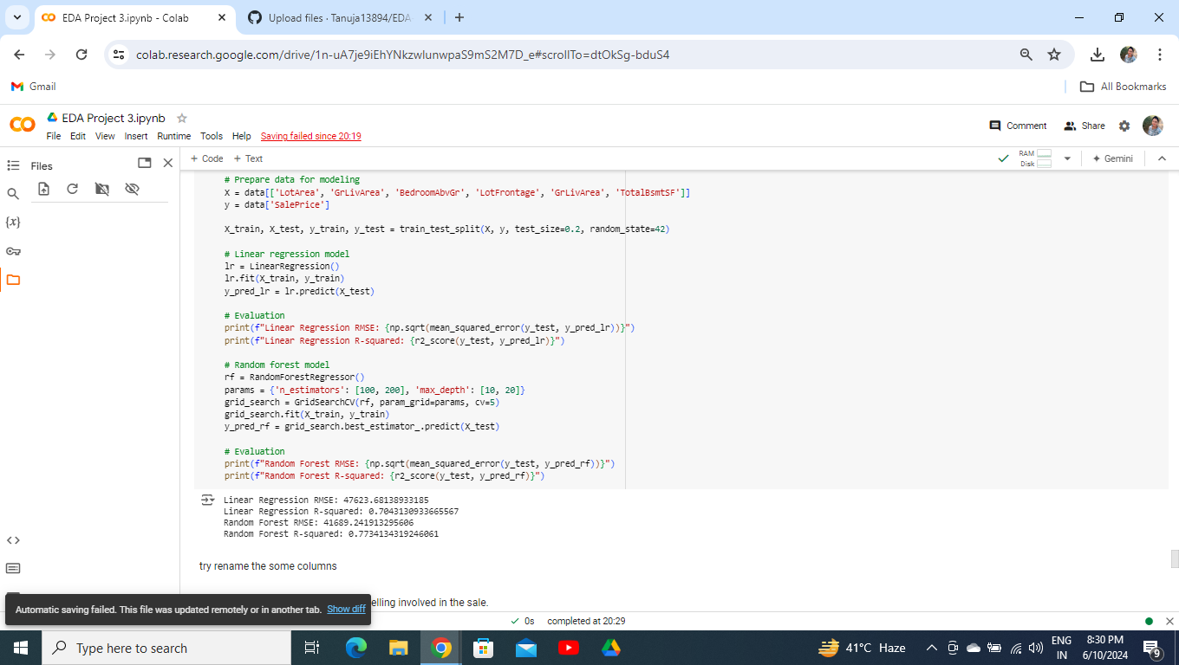
Solution:-
Get all information from google and other sources

Slide 8
METHODOLOGY
Data Collection
Data is collected from multiple sources including real estate listings, government databases, and market reports. Ensuring data quality and consistency is paramount.
Data Cleaning and Preparation
Handle missing values and outliers.
Normalize and standardize data.
Create new features if necessary.
Exploratory Data Analysis (EDA)
Use statistical methods and visualization tools to explore data.
Identify relationships and patterns among variables.
Modeling
Apply machine learning algorithms such as linear regression, decision trees, or neural networks.
Use cross-validation and hyperparameter tuning to improve model performance.
Evaluate models using metrics like RMSE, MAE, and R-squared.
Visualization
Create interactive dashboards and static plots to visualize trends and predictions.
Use tools like Matplotlib, Seaborn, for visualization.
Reporting
Compile findings into reports that highlight key insights.
Provide actionable recommendations based on the analysis.

Slide 9
KEY FEATURES:-
The housing dataset typically includes a variety of features that provide detailed information about each property. These features are crucial for conducting a thorough analysis and for building predictive models. Here is an overview of the key features often found in housing data:
Property Characteristics
Location and Geography
Financial Information
Structural Features
Amenities and Features
Market and Temporal Data
Demographic and Environmental Feature
Additional Features

Slide 10
OUTPUT:-
Market insights: clear understanding of current and historical market trends.
Price predictions: accurate models to predict property prices.
Policy recommendations: insights on how various policies impact the housing market.
Enhanced decision making: data-driven decisions for stakeholders.

Slide 11
CHALLANGES FACED:-
Analyzing housing data presents numerous challenges that can impact the accuracy and reliability of the findings. Here are some of the primary challenges faced in housing data projects:
Data Quality Issues
Data Integration
Feature Engineering
Geospatial Analysis
Temporal Analysis
Predictive Modeling
Ethical and Privacy Concerns
Economic and Policy Factors
Data Visualization
Technical Challenges
Addressing These Challenges

Slide 12
CONCLUSION:-
The Housing Data Project aims to leverage data analytics to provide a comprehensive understanding of the housing market. Through meticulous data analysis, visualization, and predictive modeling, the project seeks to offer valuable insights that can guide decision-making in the real estate sector.

Slide 13
THANKU

